Slide 1
IoT system monitors smart greenhouse environment through sensor network
Group 2

Slide 2
Unit 1. Overview
1.1. Background of Traditional Agriculture & Importance of Smart Agriculture
1.2. Project Objectives
Unit 2. System Overview & Architecture
Unit 4. Software Development
2.1. System Diagram
2.2. Architectural Layers
2.3. Data Flow Diagram
4.1. Processing Algorithm Flowchart
4.2. Microcontroller Programming (Firmware)
4.3. IoT Platform Development
Unit 3. Hardware Implementation
Unit 5. Results & Future Work
3.1. Component Selection
3.2. Schematics and Wiring Diagram
5.1. Summary of Achieved Results
5.2. Project Limitations
5.3. Future Enhancements and Upgrades

Slide 3
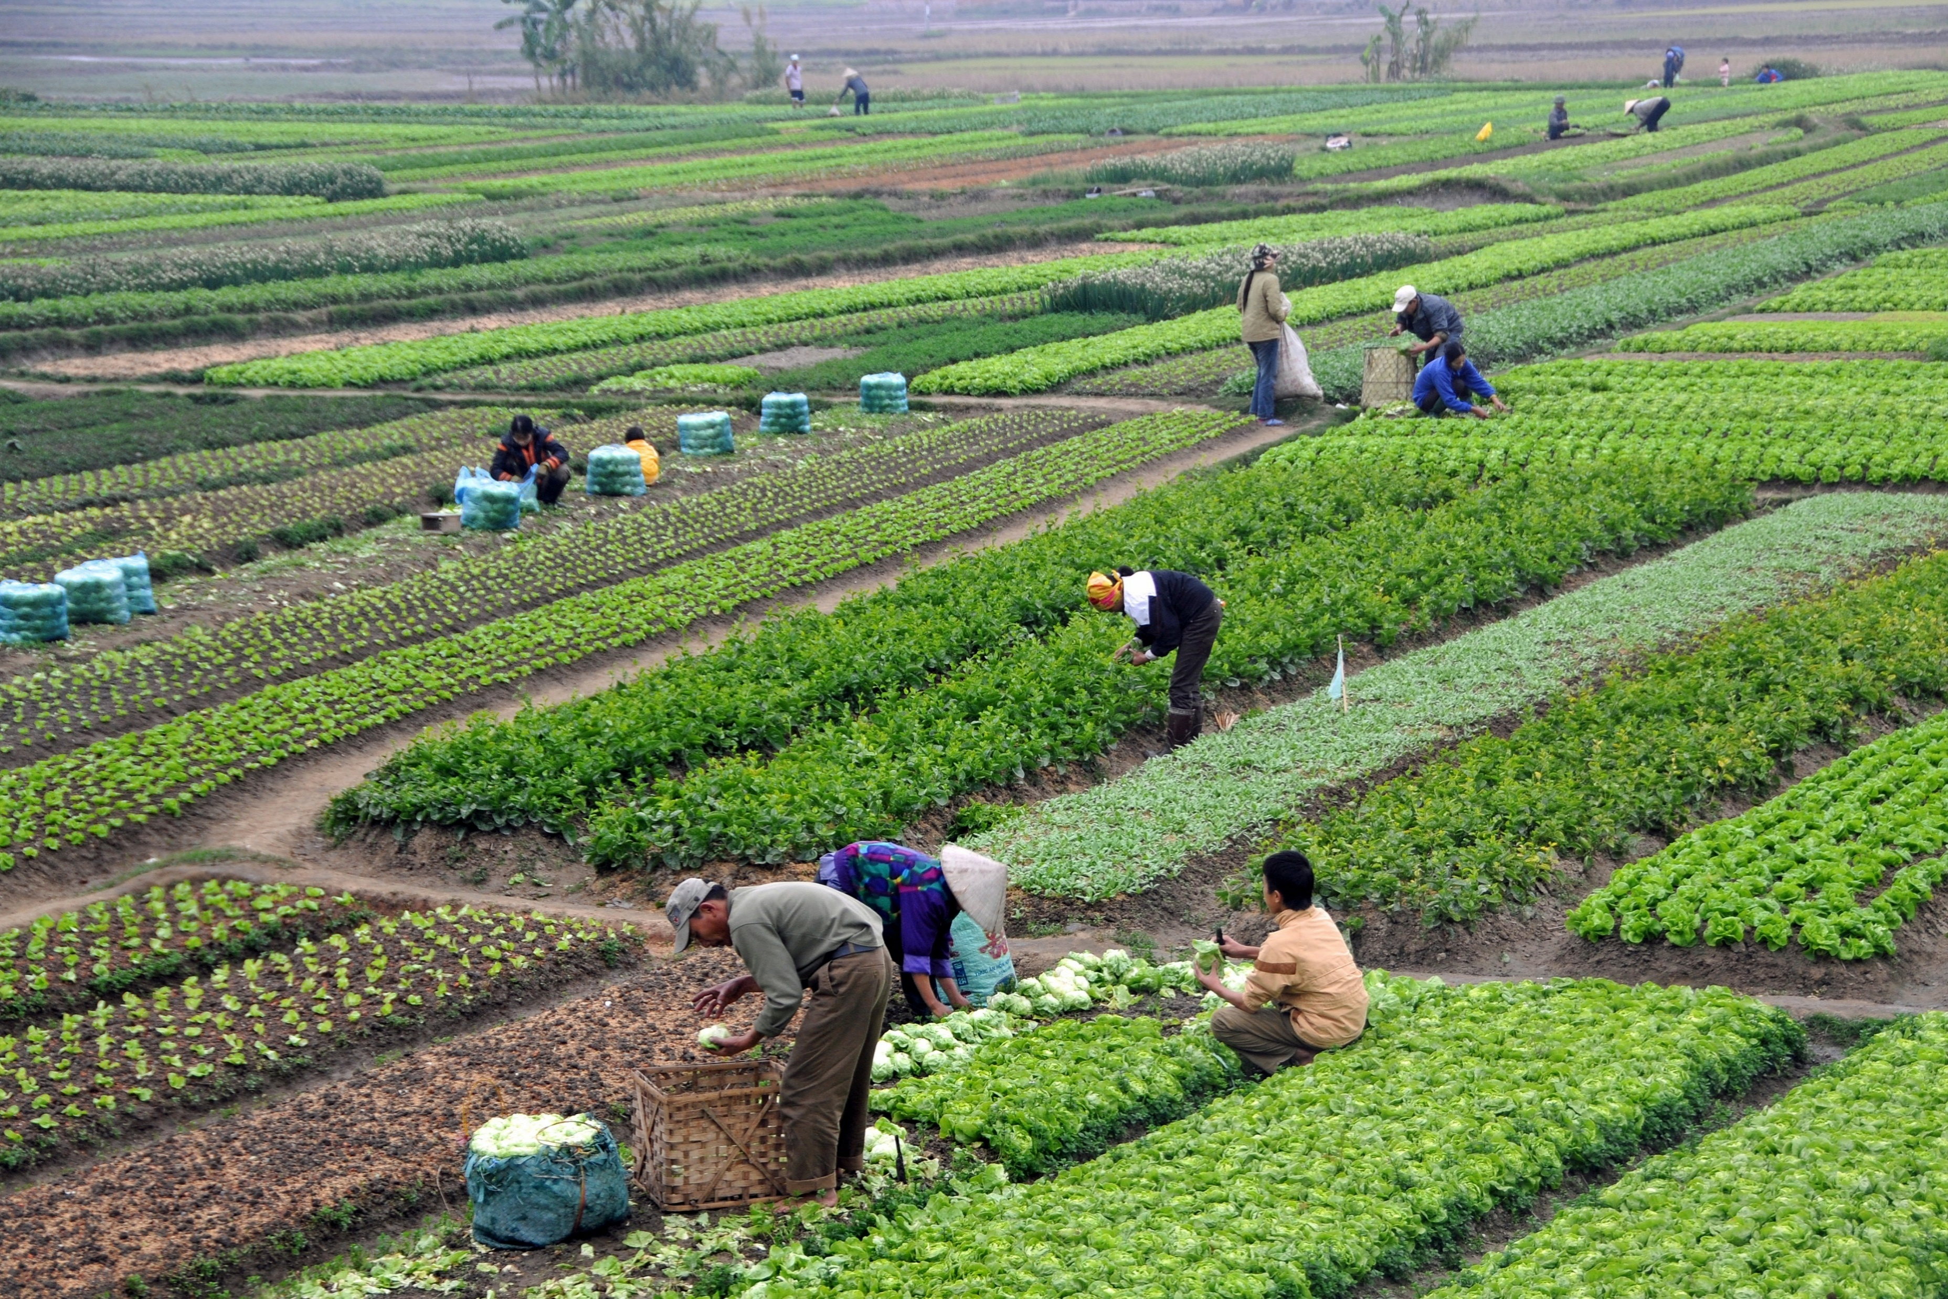
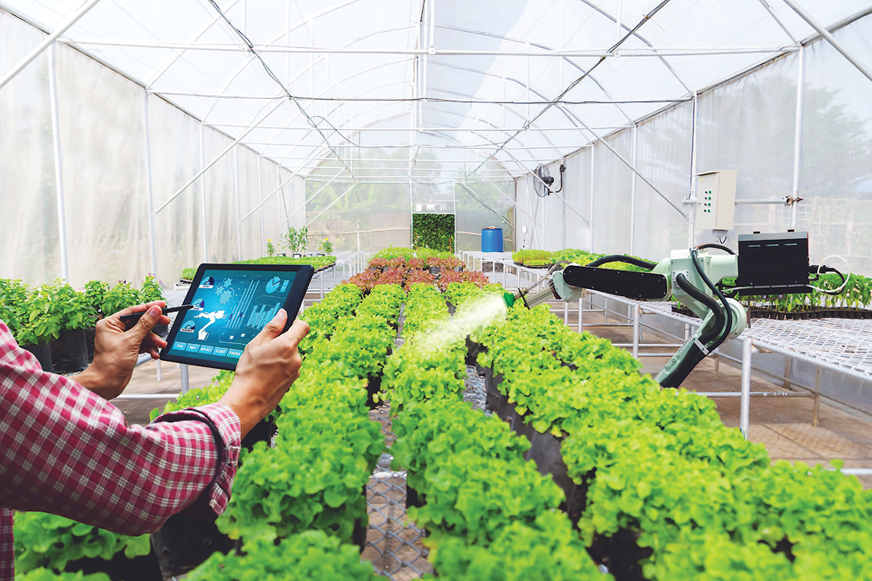
1.1
Background of Traditional Agriculture & Importance of Smart Agriculture
UNIT
01
Agriculture in Vietnam is mostly traditional agriculture
Low labor productivity
Aversion to change, policies not yet put into practice
=> As a result, these challenges place great demands on the development of smart agriculture

Slide 4
1.1
Background of Traditional Agriculture & Importance of Smart Agriculture
UNIT
01
Agriculture in Vietnam is mostly traditional agriculture
Low labor productivity
Aversion to change, policies not yet put into practice
=> As a result, these challenges place great demands on the development of smart agriculture

Slide 5
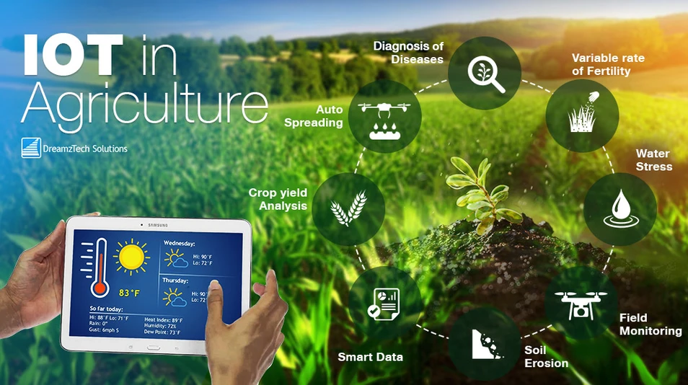
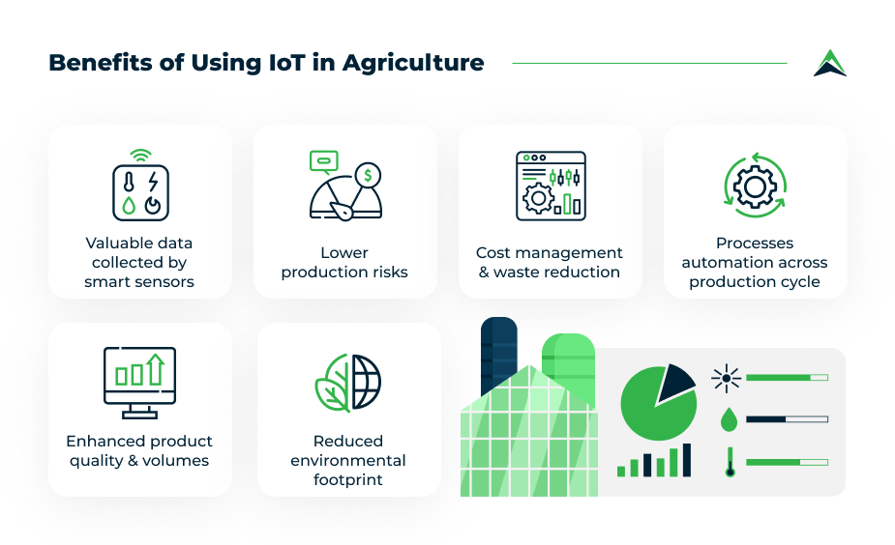
1.2
Project Objectives & Tasks
UNIT
01
Build a complete IoT system
To successfully design and implement a system capable of automated data collection, processing, and control.
Enhance management capabilities
To provide users with the ability to remotely monitor and control the greenhouse through an intuitive interface.

Slide 6
1.2
Project Objectives & Tasks
UNIT
01
Build a complete IoT system
To successfully design and implement a system capable of automated data collection, processing, and control.
Enhance management capabilities
To provide users with the ability to remotely monitor and control the greenhouse through an intuitive interface.

Slide 7
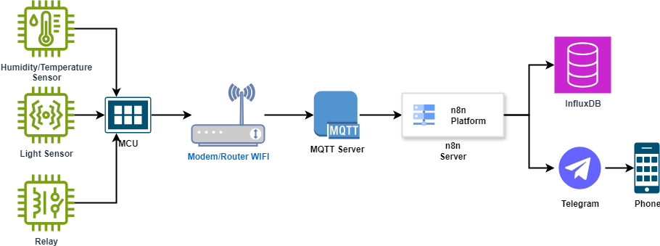
2.1
System Diagram
UNIT
02

Slide 8
2.2
Architectural Layers
UNIT
02
Perception Layer
Processing Layer
This layer acts as the "senses" of the system. It consists of sensors (DHT22, soil moisture, light) responsible for gathering raw data from the environment
Network Layer
The "brain" of the system, centered around the ESP32 microcontroller. It reads data, executes automated control logic, and communicates with the network layer.
Application Layer
This is the communication bridge, using Wi-Fi for connectivity and the MQTT protocol for lightweight and efficient data transmission to the cloud
Using n8n automation platform to connect to InfluxDB and send notifications to users via Telegram

Slide 9
2.2
Architectural Layers
UNIT
02
Perception Layer
This layer acts as the "senses" of the system. It consists of sensors (DHT22, soil moisture, light) responsible for gathering raw data from the environment
Processing Layer
The "brain" of the system, centered around the ESP32 microcontroller. It reads data, executes automated control logic, and communicates with the network layer.
Network Layer
This is the communication bridge, using Wi-Fi for connectivity and the MQTT protocol for lightweight and efficient data transmission to the cloud
Application Layer
Using n8n automation platform to connect to InfluxDB and send notifications to users via Telegram

Slide 10
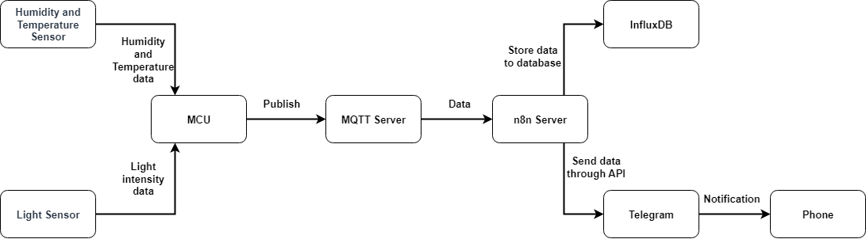
2.2
Data Flow Diagram
UNIT
02

Slide 11
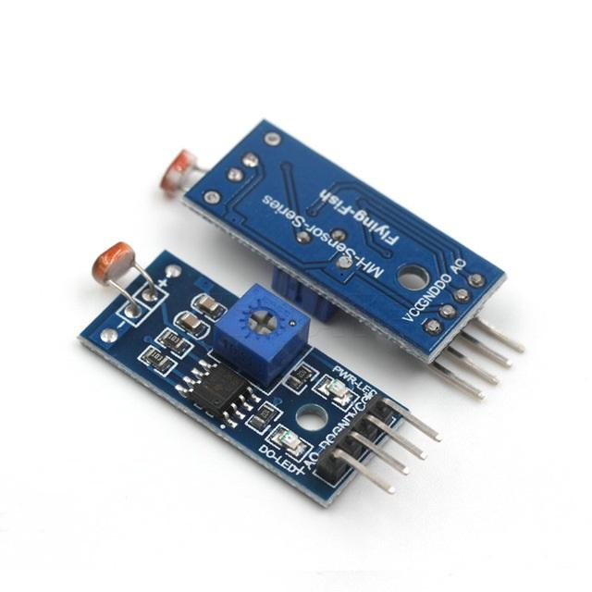
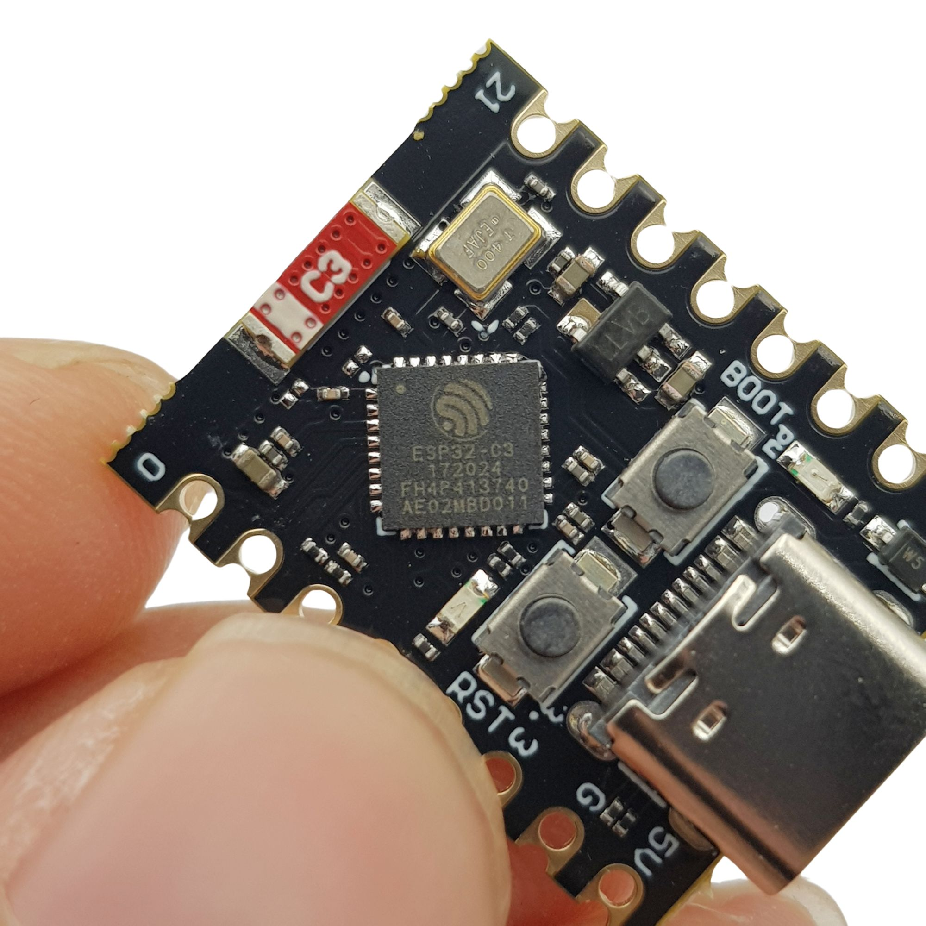
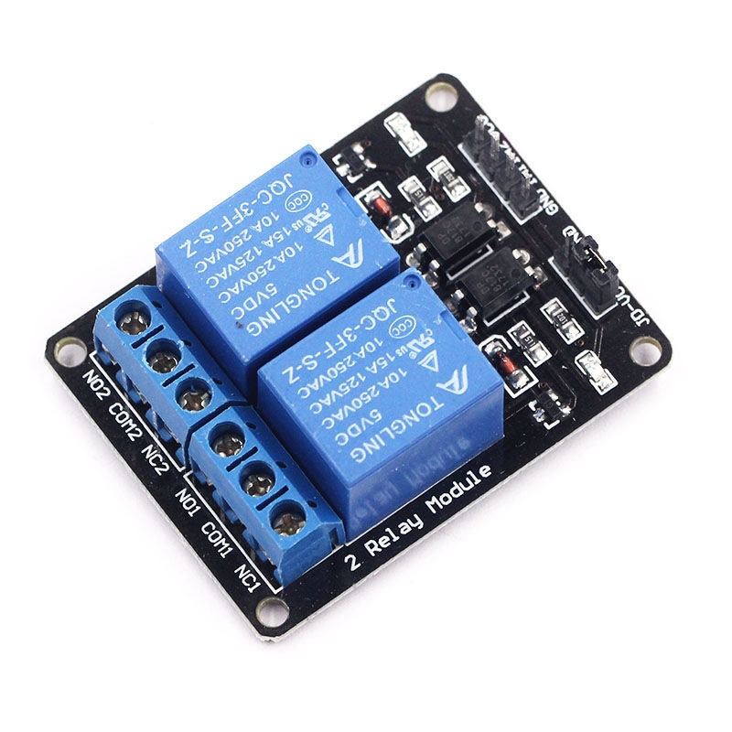
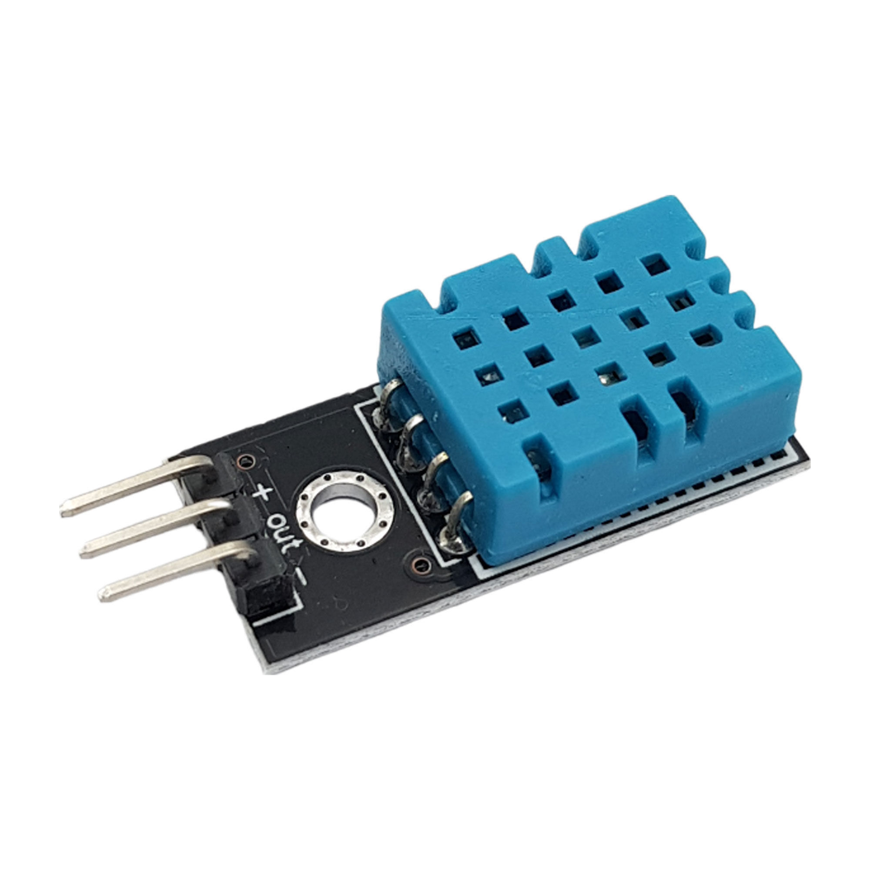
3.1
Component Selection
UNIT
03

Slide 12
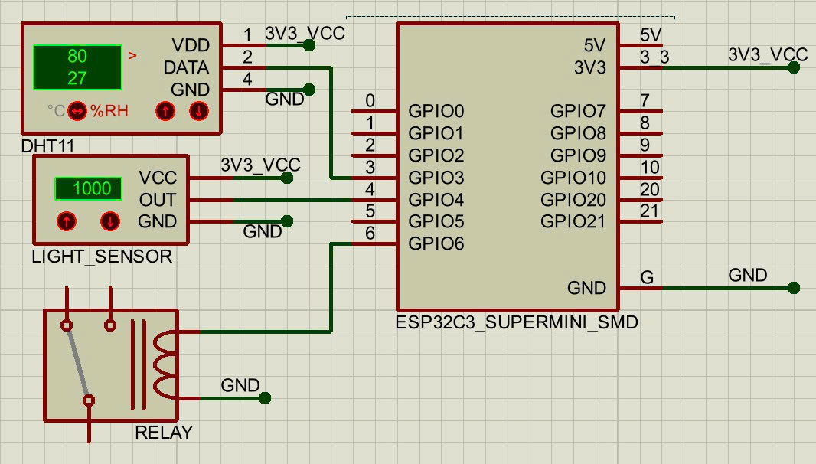
3.2
Schematics and Wiring Diagram
UNIT
03

Slide 13
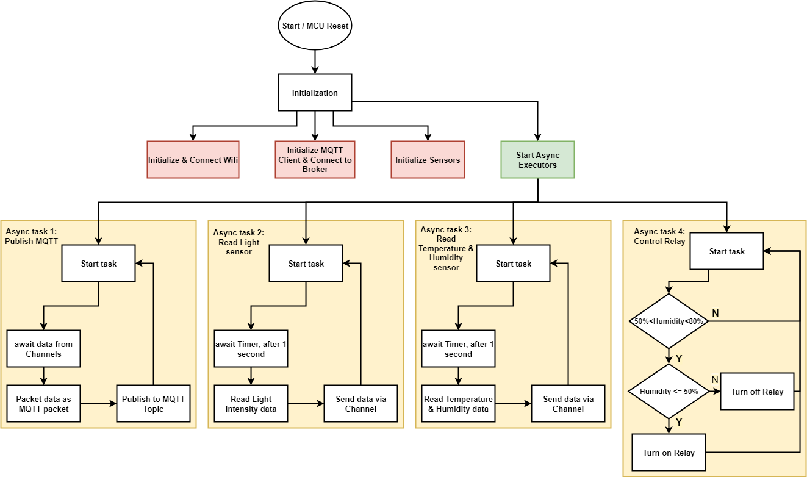
4.1
Processing Algorithm Flowchart
UNIT
04

Slide 14
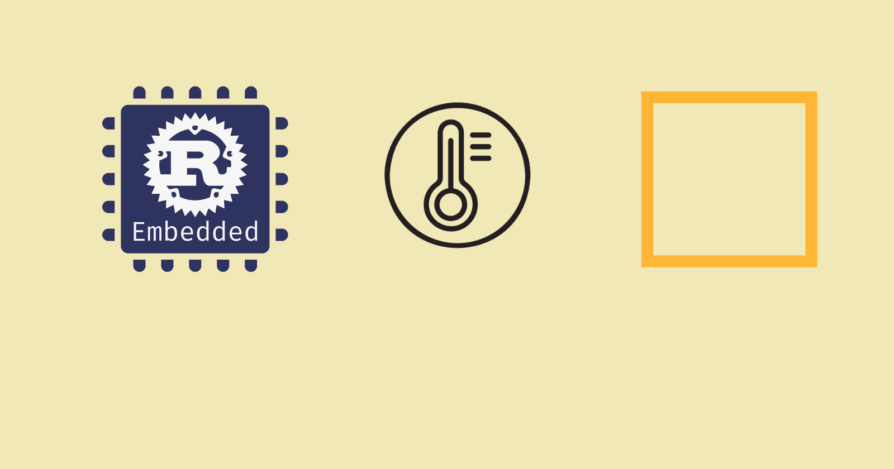
4.2
Microcontroller Programming (Firmware)
UNIT
04
Rust
(Language)
Embassy (Framework)

Slide 15

4.2
Microcontroller Programming (Firmware) (cont.)
UNIT
04
Superior Safety: Rust eliminates common memory bugs (like null pointers and buffer overflows) at compile time, leading to extremely stable and reliable firmware without sacrificing performance.
Modern Asynchronous Programming: With Embassy, the async/await syntax makes it simple to write clean, power-efficient code for handling multiple tasks at once (like Wi-Fi and sensors).
High Performance & Strong Ecosystem: You get C/C++ level speed combined with modern tools like Cargo for easy project management and a strong, supportive community.

Slide 16
4.2
Microcontroller Programming (Firmware) (cont.)
UNIT
04
Superior Safety: Rust eliminates common memory bugs (like null pointers and buffer overflows) at compile time, leading to extremely stable and reliable firmware without sacrificing performance.
Modern Asynchronous Programming: With Embassy, the async/await syntax makes it simple to write clean, power-efficient code for handling multiple tasks at once (like Wi-Fi and sensors).
High Performance & Strong Ecosystem: You get C/C++ level speed combined with modern tools like Cargo for easy project management and a strong, supportive community.

Slide 17




4.3
IoT Platform Development
UNIT
04

Slide 18
4.3
IoT Platform Development
UNIT
04

Slide 19
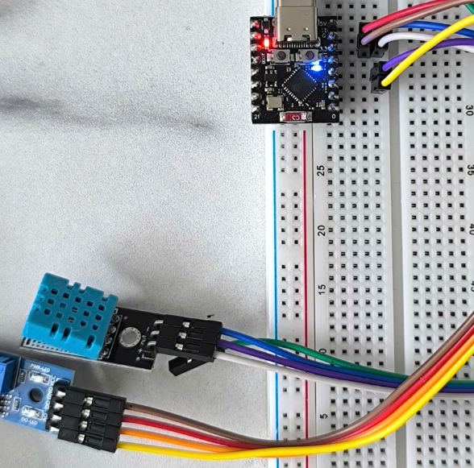
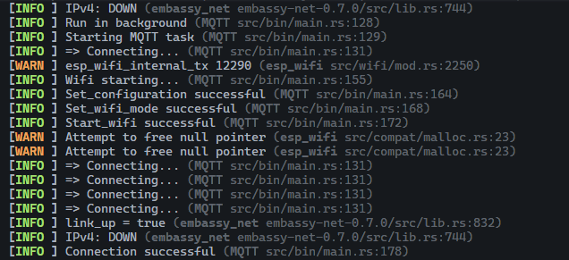
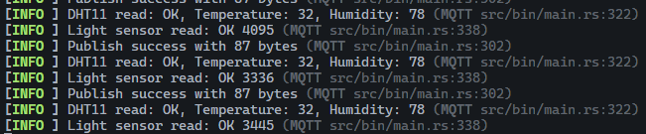
5.1
Summary of Achieved Results
UNIT
05

Slide 20
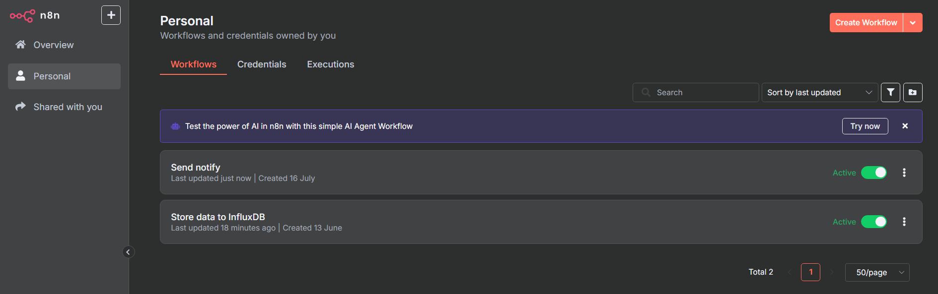
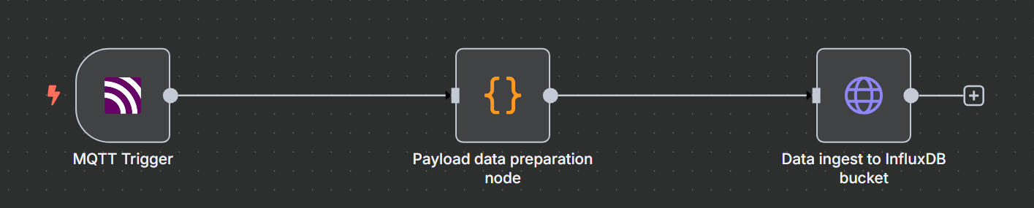
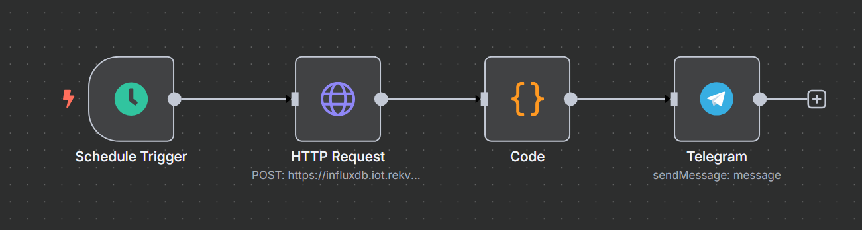
5.1
Summary of Achieved Results (cont.)
UNIT
05

Slide 21
5.1
Summary of Achieved Results (cont.)
UNIT
05

Slide 22
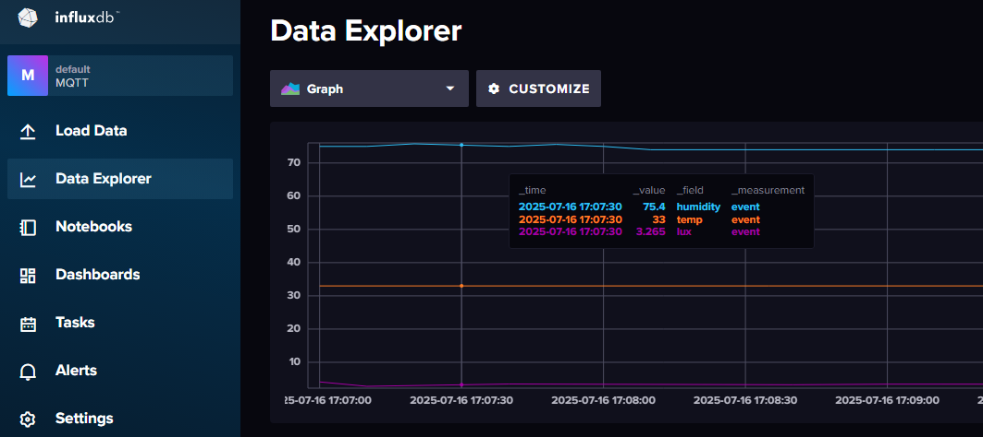
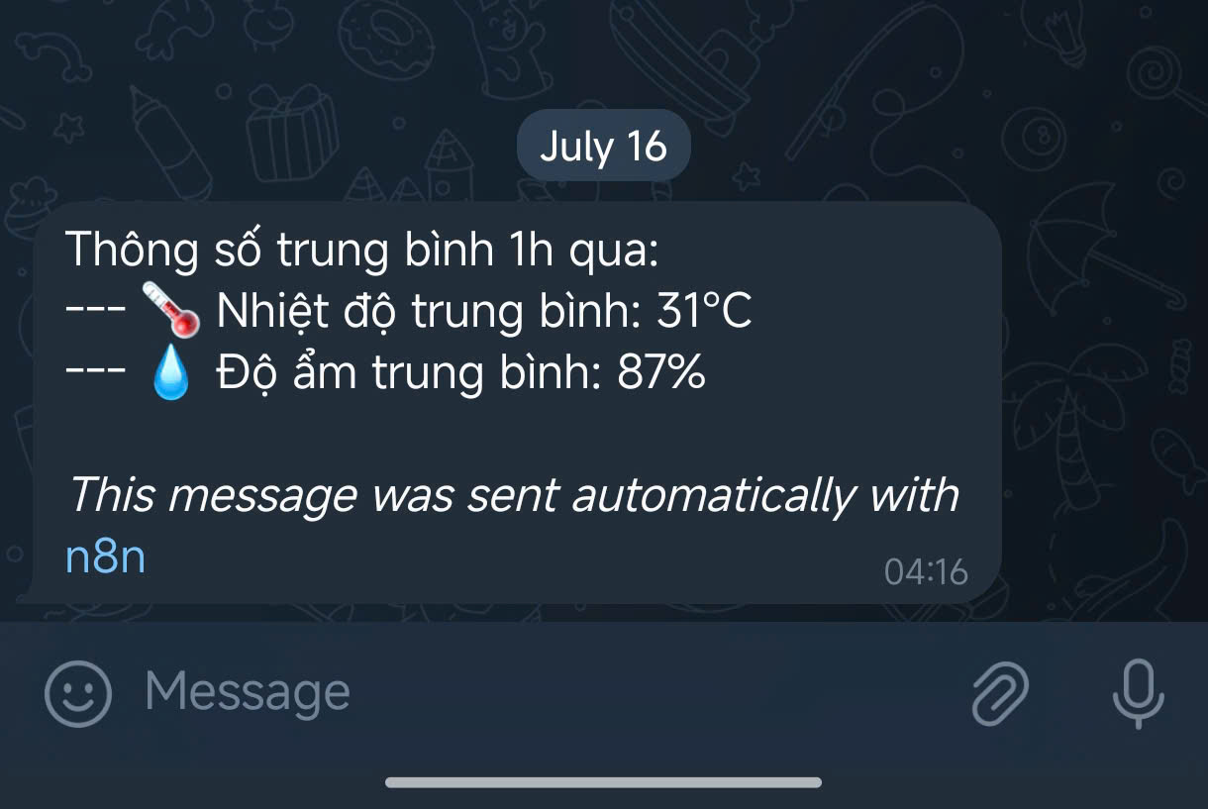
5.1
Summary of Achieved Results (cont.)
UNIT
05

Slide 23
5.2
Project Limitations
UNIT
05
Scalability: The current design is only suitable for a small-scale model. Applying it to a large, commercial greenhouse would require significant upgrades in hardware, network architecture (perhaps switching to LoRaWAN for better range), and backend processing power.
Component Durability: The components used (sensors, etc.) are primarily for educational and prototyping purposes. They may not be durable enough to operate reliably over a long period in the actual hot and humid environment of a greenhouse..
Security: Current security measures are at a basic level (e.g., Wi-Fi password, IoT platform authentication tokens). The system is not yet equipped with advanced mechanisms like end-to-end encryption or protection against physical tampering.

Slide 24
5.3
Future Enhancements and Upgrades
UNIT
05
AI/ML Integration: Instead of using simple if-then rules, we plan to collect long-term data to train a Machine Learning model. The goal is for the system to predict the plants' needs and automatically optimize watering and lighting schedules, leading to smarter resource savings and increased yield.
Energy Autonomy: To solve the dependency on the power grid, the system will be upgraded to use solar power. “Renewable Energy for Green Agriculture.”
Dedicated Mobile App: Instead of relying solely on a web dashboard, we will develop a dedicated mobile application for both iOS and Android. This app will offer a better user experience, provide instant push notifications, and allow for the convenient management of multiple greenhouses at once.

